Slide 1
Uncertainty Analysis Methodologies
Dr. Marina Perez

Slide 2
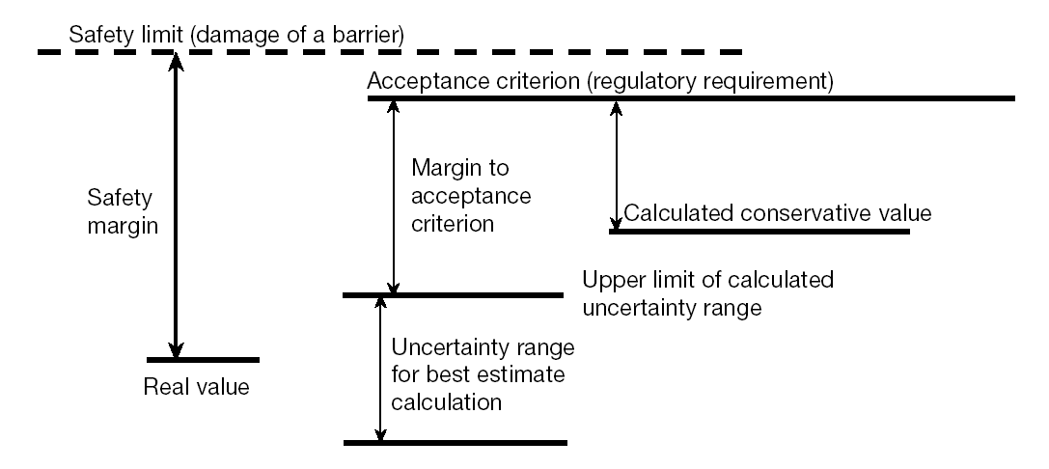
Safety analysis
Safety analysis are analytical evaluations of physical phenomena at NPPs to demonstrate that safety requirements are met.
The main objective is to prove that an adequate margin exist between the (unknown) real value and the threshold value at which the barriers against release of radioactivity would fail.

Slide 3
Safety analysis
Safety analysis are analytical evaluations of physical phenomena at NPPs to demonstrate that safety requirements are met.
The main objective is to prove that an adequate margin exist between the (unknown) real value and the threshold value at which the barriers against release of radioactivity would fail.
Conservative approach
Deliberate pessimism and simplified models
E.g. PCT_{conservative} ≥ PCT_{actual}

Slide 4
Safety analysis
Safety analysis are analytical evaluations of physical phenomena at NPPs to demonstrate that safety requirements are met.
The main objective is to prove that an adequate margin exist between the (unknown) real value and the threshold value at which the barriers against release of radioactivity would fail.
Best estimate approach
Realistic model & evaluation of uncertainty
E.g. PCT_{BE} – PCT’_{unc} ≤ PCT_{real} ≤ PCT_{BE} + PCT_{unc}

Slide 5
Regulation
1974 USNRC 10 CFR 50.46 Acceptance criteria for ECCS for light-water nuclear power reactors.
Acceptance criteria:
Maximum zircalloy temperature < 2200 F (1478 K)
Maximum oxidation of cladding < 17% of the cladding thickness before oxidation
Maximum amount of hydrogen generated from the chemical reaction of the cladding with water or steam < 1% of potential
Core geometry must be retained in a coolable condition
Long term cooling must be provided
Conservative method (Appendix K to 10 CFR 50.46)

Slide 6
Research during 1974-1988
Research efforts in three fields:
Experimental data (SETs and IETs);
Development of thermal-hydraulic best-estimate computer codes such as ATHLET, CATHARE, RELAP5, TRAC; and
Validation and verification of the best-estimate computer codes (comparative exercises, validation matrices),
set the technical basis for the amended regulations requirements approved in 1988 and published in May 1989 by the USNRC.

Slide 7
1989 revised rule
1989 USNCR 10 CFR 50.46 Revised rule & Regulatory Guide 1.157
Acceptance criteria (same as 1974 regulation)
Conservative method (Appendix K to 10 CFR 50.46) or best-estimate approach using a realistic model provided an uncertainty quantification of the results (Regulatory Guide 1.157).
USNRC CSAU methodology (guidelines), see NED 119(1990) 1-117 and NUREG/CR-5249 EGG-2552.

Slide 8
Sources of uncertainty
Three major sources of uncertainty:
Code or model uncertainty:
Code models and correlations;
Solution schemes;
Unmodeled processes;
Availability of multiple models to simulate the same phenomenon;
Data libraries and code deficiencies.
Representation or simulation uncertainty:
How well is the real geometry represented by the elements available in the code: volumes, heat structures, special components (e.g. accumulator), 3D effects, scaling and control components.
Plant uncertainty:
Measuring of the real plant: reference plant parameters, instrumentation error, set points.
“user effect”
Variability introduced to calculation results of the same problem and code but performed by different users: interpretation and quality of the available documentation, user expertise, errors in input deck.
Should be mitigated by using proper code documentation, staff training, experienced supervision.

Slide 9
Uncertainty methodologies
IAEA classification:
Option | Computer code | Availability of systems | Initial and boundary conditions | Approach
1 | Conservative | Conservative assumptions | Conservative | Conservative
2 | Best estimate (realistic) | Conservative assumptions | Conservative | Combined
3 | Best estimate + uncertainty | Conservative assumptions | Realistic input data + uncertainties | Best-estimate
4 | Best estimate + uncertainty | Derived from probabilistic safety analysis | Realistic input data plus uncertainties | Risk informed

Slide 10
Uncertainty methodologies
IAEA classification:
Option 3: Best Estimate Plus Uncertainty (BEPU)
Option | Computer code | Availability of systems | Initial and boundary conditions | Approach
1 | Conservative | Conservative assumptions | Conservative | Conservative
2 | Best estimate (realistic) | Conservative assumptions | Conservative | Combined
3 | Best estimate + uncertainty | Conservative assumptions | Realistic input data + uncertainties | Best-estimate
4 | Best estimate + uncertainty | Derived from probabilistic safety analysis | Realistic input data plus uncertainties | Risk informed

Slide 11
BEPU methodologies
BEPU approaches:
Propagation of input uncertainty
Probabilistic methods (CSAU, GRS, …)
Deterministic methods (AEAT)
Extrapolation of output uncertainty (CIAU)

Slide 12
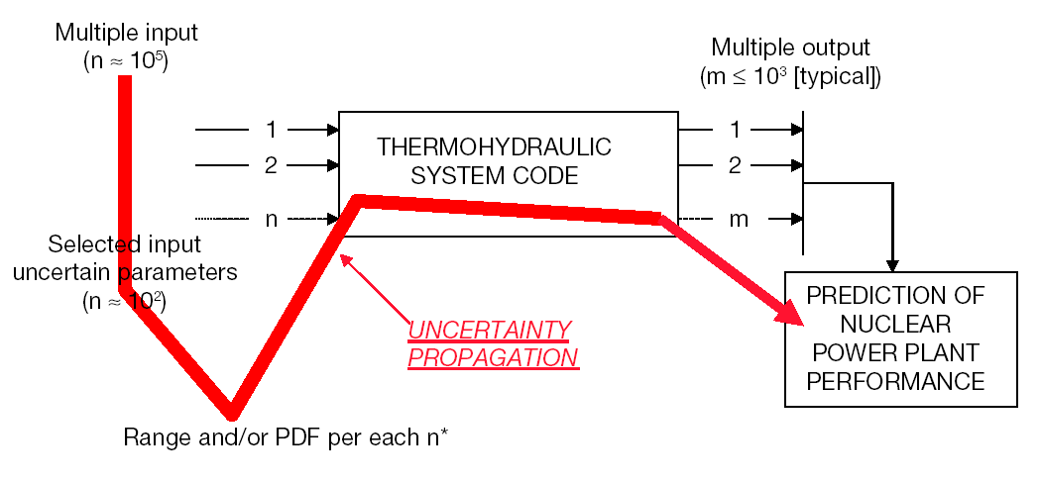
Propagation of input uncertainty

Slide 13
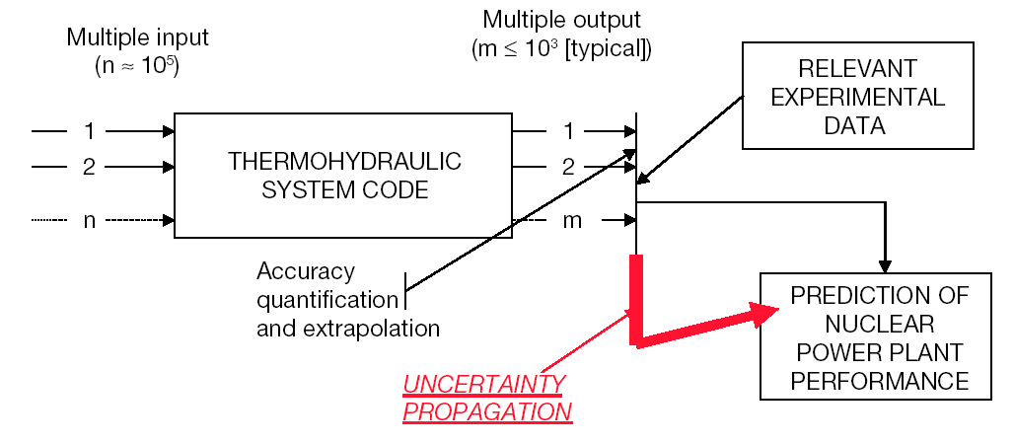
Extrapolation of output uncertainty

Slide 14
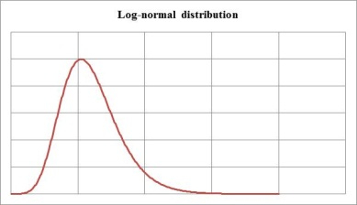
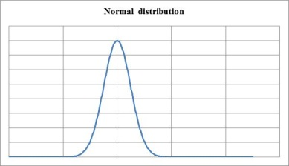
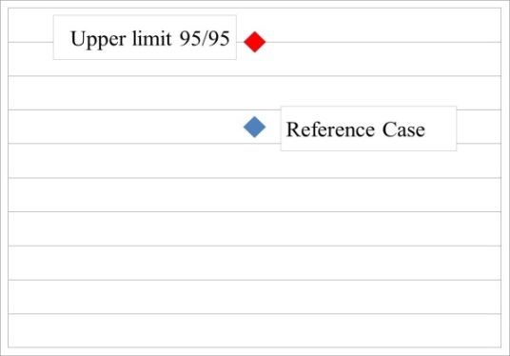
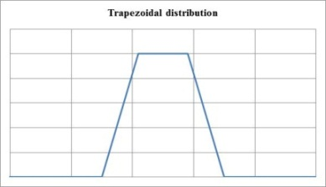
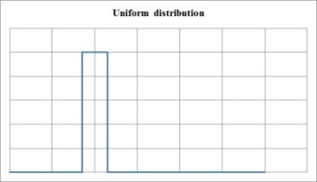
Probabilistic approach
Main elements of a probabilistic methodology:
Uncertainty is defined by Probabilistic Distribution Functions (PDFs);
Wilks’ formula* determines the number of code calculations N;
Order statistics.
10⁵ inputs
Input deck 1
Input deck 2
…
Input deck N
Output 1
Output 2
…
Output N
CODE
Selected m inputs

Slide 15


Probabilistic approach
Wilk’s formula:
Tolerance interval/limit of the percentile γ and confidence β
, where N is the number of calculations, I(i,j,k) is the incomplete beta function, and 0≤s<r≤N
Example
At 1st order, the two-sided tolerance interval (i.e. r=1 and s=N)
At 1st order, the one-sided tolerance limit (i.e. r=0 and s=N)
!

Slide 16
Probabilistic approach: Wilks’ formula
One-sided tolerance limit
Order | γ = β = 0.95 | γ = 0.95, β = 0.99
1st | N=59 | N=90
2nd | N=93 | N=130
3rd | N=124 | N=165
4th | N=153 | N=198
5th | N=181 | N=229

Slide 17
Probabilistic approach
Steps of a probabilistic methodology:
Selection of the plant and scenario;
Selection of the safety criteria;
Identification of the relevant phenomena based on the safety criteria;
Selection of the appropriate code parameters to represent those phenomena;
Association of Probability Density Functions for each code parameter;
Random sampling of the selected parameters according to their PDF and performing multiple computer runs to obtain the uncertainty bands with a certain percentile and confidence level (Wilks’ formula);
Processing of the results to estimate the uncertainty bands for the computed quantities associated with the selected safety criteria.

Slide 18
BEMUSE exercise
Best Estimate Methods – Uncertainty and Sensitivity Evaluation
Phase I: a priori presentation of the uncertainty evaluation methodology to be used by participants and, if needed, definition of model basic uncertainties to be used.
Phase II: Post-test analysis of LOFT L2-5 LB-LOCA experiment (ISP-13 re-analysis).
Phase III: Uncertainty evaluation of the L2-5 test calculations, and related sensitivity studies; first conclusions on the methods and suggestions for improvement.
Phase IV: BE and sensitivity analysis of the LB-LOCA in a Nuclear power plant.
Phase V: Uncertainty evaluation for the NPP-LB-LOCA.
Phase VI: Status report on the area, classification of the methods, respective conclusions and recommendations.

Slide 19
UPC contribution to phase III
Technical University of Catalonia (UPC) participated (F.Reventós, L.Batet, M.Pérez) in phase III with the sponsorship of the Spanish regulatory body (CSN) using GRS-based methodology developed by ENUSA
The uncertain parameters were established by using a PIRT (Phenomena Identification and Ranking Table) for a LB-LOCA scenario.
Sources of uncertainty considered:
Initial and boundary conditions (including material properties)
Geometrical data
Physical models
14 input uncertain parameters were selected. A sPDF was associated to each parameter and SRS (Simple Random Sampling) was used to obtain the needed number of inputs.

Slide 20
UPC contribution to Phase III Uncertainty parameters

Slide 21
UPC contribution to Phase III Wilks’ formula
Wilks formula at 2nd order determines that 93 calculations are needed to obtain two one-sided tolerance limits (the uncertainty bounds), giving respectively an estimation of the 5th and the 95th percentiles, with a confidence level of 95% for both limits.
UPC run 100 calculations (confidence level for uncertainty bounds is slightly higher than 95 %)

Slide 22
UPC contribution to Phase III Implementation of the methodology
Polynomial distribution function
param13 (data001)
param13 (data002)
…
param13 (dataxxx)
…
param13 (data100)
param13
SIMPLE RANDOM SAMPLING (SRS)

Slide 23
UPC contribution to Phase III Implementation of the methodology
InputAAA
+
c------------------------------
c Uncertainty analysis
open(90,status='old',file='data.txt')
read(90,*) dataAAA
open(91,status='old',file= dataAAA)
do 10 j=1,14
read(91,*) param(j)
write(*,*) param(j)
10 continue
dataAAA
param01
param02
param03
param04
param05
param06
param07
param08
param09
param10
param11
param12
param13
param14
dataAAA
param01
param02
param03
param04
param05
param06
param07
param08
param09
param10
param11
param12
param13
param14
RELAP5 mod3.3
OutputAAA
call dittus
htcf = htcfsv
hv = htcoef
c---------------------------------
c param(13)
hv = hv*param(13)
c---------------------------------
data.txt
dataAAA

Slide 24
UPC contribution to Phase III Uncertainty bands

